Slide 1
Early
Christianity
or
Early
Christianities

Slide 2
Early Christianity [or Christianities]?
DIVERSITY
&
CONFLICT
UNITY
&
CONTINUITY
OR

Slide 3
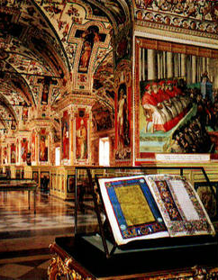
Early Christianity [or Christianities]?
“A people without a history are easily persuaded.”
—Karl Marx
Christians who don’t know their history can be easily deceived.

Slide 4







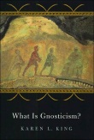



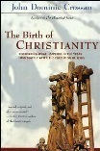



Early Christianity [or Christianities]?

Slide 5
Early Christianity [or Christianities]?
DIVERSITY +
CONFLICT
UNITY + CONTINUITY

Slide 6
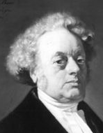
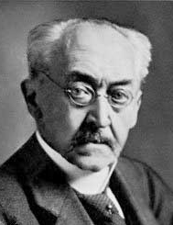
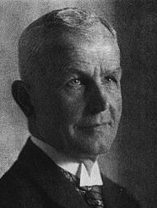
Early Christianity [or Christianities]?
Ferdinand Christian Baur (1792–1860)
Christianity as found in the Bible and early church was really a synthesis of competing perspectives on Jesus and the gospel.
Adolf von Harnack (1851–1930)
In the earliest church Christianity was “hellenized,” distorted by Greco-Roman philosophy, religion, and culture.
Walter Bauer (1877–1960)
So-called “Orthodoxy” did not precede “heresy,” but in many regions heresy was the original manifestation of Christianity!

Slide 7
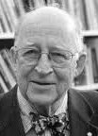
Early Christianity [or Christianities]?
Christianity did not begin with a particular belief, dogma or creed; nor can one understand the heretical diversifications of early Christianity as aberrations from one original true and orthodox formulation of faith. Rather, Christianity started with a particular historical person, his works and words, his life and death: Jesus of Nazareth.
HELMUT KOESTER
Research Professor of Divinity and Ecclesiastical History, Harvard Divinity School

Slide 8
Early Christianity [or Christianities]?
Creed and faith, symbol and dogma are merely the expressions of response to this Jesus of history. . . . The diversifications of this response were caused, and still today are caused, by two factors: first, by the several different religious and cultural conditions and traditions of the people who became Christians; and, second, by the bewildering though challenging impact of Jesus’ own life, works, words, and death.
HELMUT KOESTER
Research Professor of Divinity and Ecclesiastical History, Harvard Divinity School

Slide 9

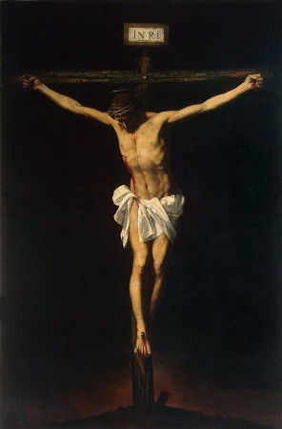
Early Christianity [or Christianities]?

Slide 10

Early Christianity [or Christianities]?
CLAIMS OF THE CRITICS
AD 50

Slide 11

Early Christianity [or Christianities]?
One form of Christianity decided what was the “correct” Christian perspective; it decided who could exercise authority over Christian belief and practice; and it deter-mined what forms of Christianity would be marginalized, set aside, destroyed. It also decided which books to canonize into Scripture and which books to set aside as “heretical,” teaching false ideas.
BART EHRMAN
Chair, Department of Religious Studies,
The University of North Carolina at Chapel Hill

Slide 12
Early Christianity [or Christianities]?
And then, as a coup de grace, this victorious party rewrote the history of the controversy, making it appear that there had not been much of a conflict at all, claiming that its own views had always been those of the majority of Christians at all times, back to the time of Jesus and his apostles, that its perspective, in effect, had always been “orthodox” (i.e., the “right belief”) …
BART EHRMAN
Chair, Department of Religious Studies,
The University of North Carolina at Chapel Hill

Slide 13
Early Christianity [or Christianities]?
and that its opponents in the conflict, with their other scriptural texts, had always represented small splinter groups invested in deceiving people into “heresy.”
Bart D. Ehrman, Lost Christianities: The Battles for Scripture and the Faiths We Never Knew (Oxford: Oxford University Press, 2003), 4.
BART EHRMAN
Chair, Department of Religious Studies,
The University of North Carolina at Chapel Hill

Slide 14
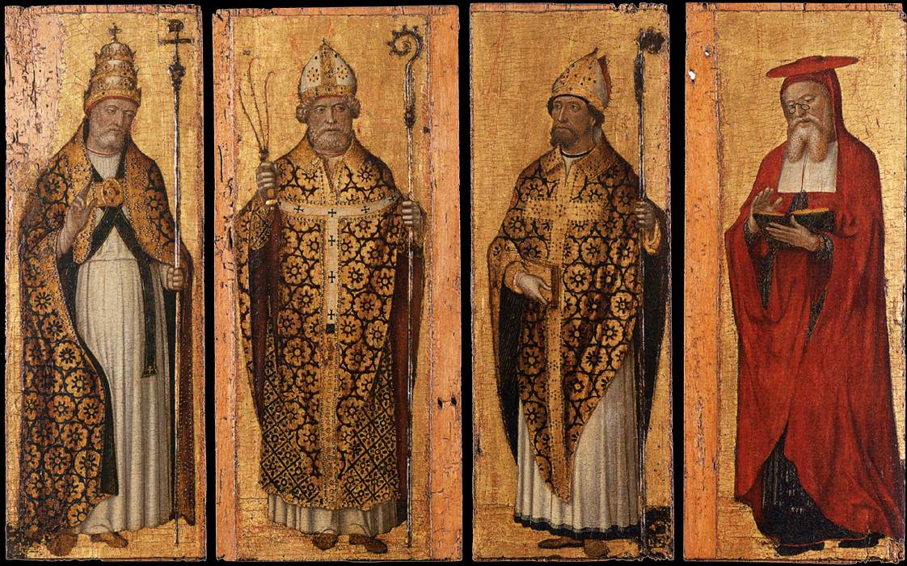

Early Christianity [or Christianities]?

Slide 15
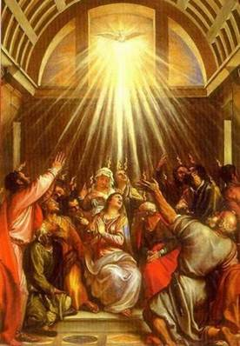
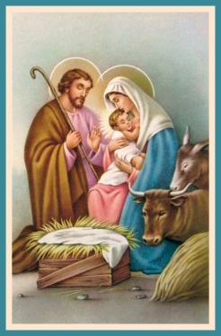

Early Christianity [or Christianities]?

Slide 16
Early Christianity [or Christianities]?
CLAIM OF THE CRITICS
AD 50

Slide 17
Early Christianity [or Christianities]?
CLAIM OF THE CRITICS
AD 100

Slide 18
Early Christianity [or Christianities]?
CLAIM OF THE CRITICS
AD 150

Slide 19
Early Christianity [or Christianities]?
CLAIM OF THE CRITICS
AD 200

Slide 20
Early Christianity [or Christianities]?
CLAIM OF THE CRITICS
AD 250

